Slide 1



Library Management System
Presented by
B SANDEEPKUMAR

Slide 2
Introduction
This project focuses on designing and analyzing a Library Database Management System using SQL. The system models real-world library operations by efficiently managing data related to books, authors, publishers, library branches, borrowers, and loan transactions. By creating a structured relational database with appropriate constraints and relationships, the project enables accurate data storage, retrieval, and analysis. The primary objective is to answer business-oriented queries that help libraries track book availability, borrowing activity, and branch-wise performance using SQL queries.

Slide 3
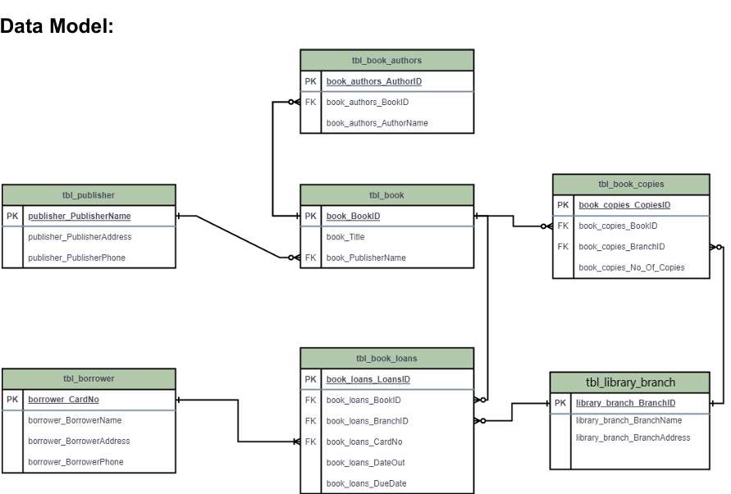
ER Diagram

Slide 4
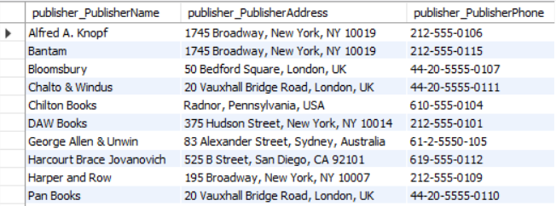
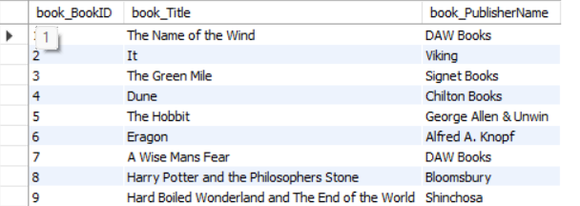
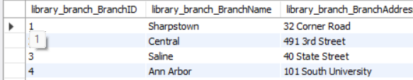
Publisher Table
Table
Book Table
Library branch Table

Slide 5
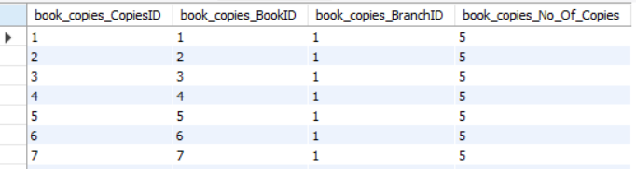
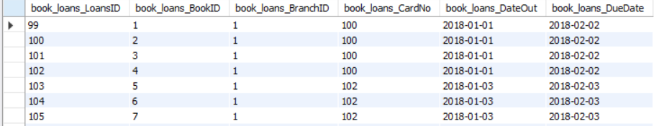
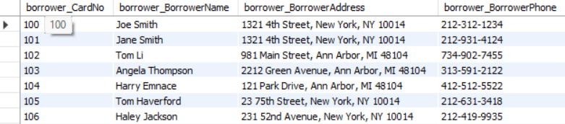
Book copies Table
Book_loans Table
Borrower Table

Slide 6
PROBLEM STATEMENT
Libraries manage large volumes of data related to books, authors, publishers, library branches, borrowers, and loan transactions. Traditional or unstructured data management methods often lead to data redundancy, inconsistency, and difficulty in tracking book availability and borrower activity. There is a need for a centralized, well-structured relational database system that can efficiently store, manage, and retrieve library data while ensuring data integrity and supporting meaningful analytical queries. This project aims to design and implement such a database using SQL to accurately model real-world library operations and answer key operational questions.

Slide 7
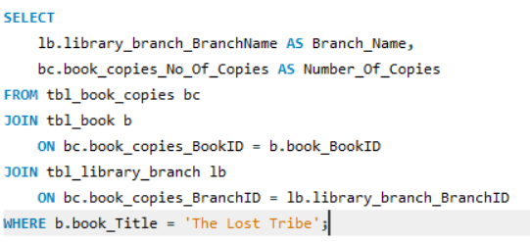
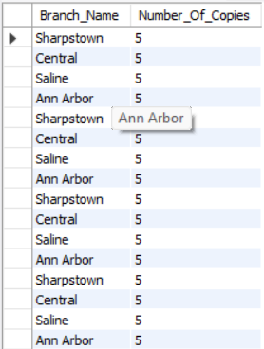
1. How many copies of the book titled "The Lost Tribe" are owned by each library branch?
Query Output

Slide 8
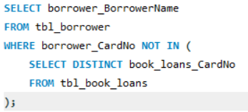

2 Retrieve the names of all borrowers who do not have any books checked out.?
Query Output

Slide 9
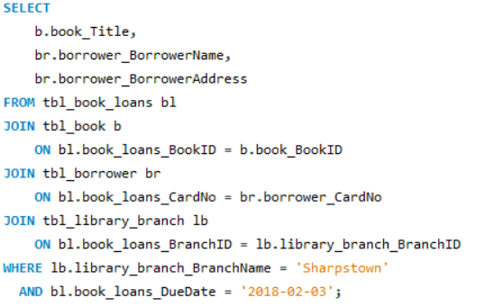
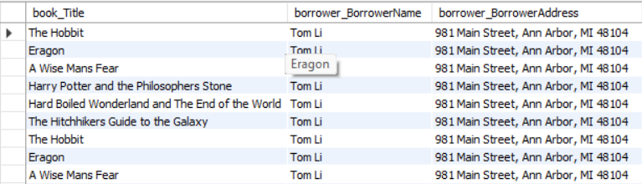
3 For each book that is loaned out from the "Sharpstown" branch and whose Due Date is 2/3/18, retrieve the book title, the borrower's name, and the borrower's address?
Query Output

Slide 10
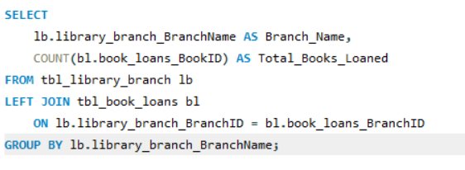
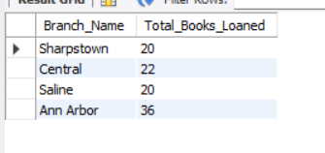
For each library branch, retrieve the branch name and the total number of books loaned out from that branch.?
Query
Output

Slide 11
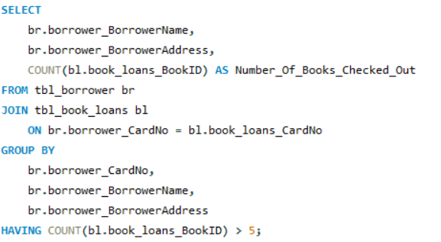
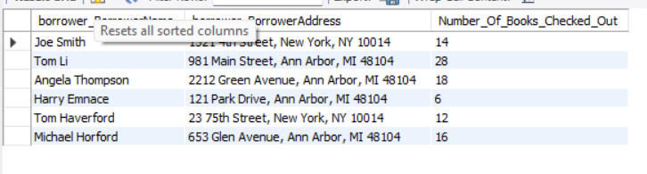
Retrieve the names, addresses, and number of books checked out for all borrowers who have more than five books checked out. ?
Query
Output

Slide 12
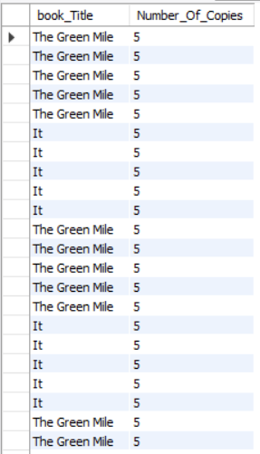
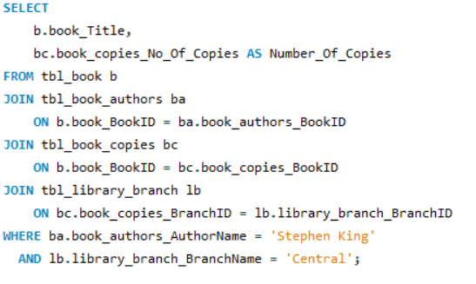
For each book authored by "Stephen King", retrieve the title and the number of copies owned by the library branch whose name is "Central"?
Query
Output

Slide 13

THANK YOU

